Slide 1

EY Techathon 6.0 Executive Summary
Date of submission: 07-11-2025

Slide 2
Quick introduction

Slide 3
We’re a team of three CSE undergrads from VNIT Nagpur.
Our combined strengths – Python development, AI Workflow design, and UI/UX – make us capable of delivering a complete agentic AI solution.
01#
Anurag Marda
-Leads technical development; implements Python automation and AI logic for data validation & reporting
-Python, Pandas, BeautifulSoup, Streamlit, File Handling, Data Processing
02#
Supraja Soudu
-Designs user-friendly dashboards and presentation visuals for intuitive interaction and data visualization
-Canva, Figma, Streamlit UI, PowerPoint Design, User Experience
03#
Shravya Puram
-Develops and tunes logic for data enrichment and quality scoring using agentic design principles
-Data Cleaning, AI Workflow Design, SQL, Data Quality Metrics, Prompt Engineering

Slide 4

Healthcare Provider Directory Validation
This challenge outlines the critical problem of inaccurate healthcare provider directories, its far-reaching consequences, and the rationale for addressing it with Agentic AI. It highlights the inefficiencies of current manual processes and the urgent need for an automated, intelligent solution to ensure data accuracy and regulatory compliance.
Inaccurate Provider Data: A Pervasive Problem
What: Over 70% of healthcare provider directory entries contain outdated or inconsistent information.
Where: This issue affects all aspects of healthcare operations, from patient access to claims processing.
Who: Impacts patients, healthcare providers, payers, and regulatory bodies.
Why: Manual verification processes are slow, costly, and prone to errors. Data sources are fragmented and lack real-time updates.
How: Inaccurate contact details, incorrect specializations, outdated license information, and missing locations.
Why It Matters: Impact and Urgency
Business Impact: Leads to increased operational costs due to claim rejections, compliance penalties, and wasted resources.
User Impact: Hinders patient access to care, causes delays in treatment, and erodes trust in the healthcare system.
Technical Impact: Creates data silos, limits interoperability, and impedes the adoption of advanced healthcare technologies.
Urgency: Regulatory mandates (e.g., No Surprises Act) require accurate and up-to-date provider directories, increasing the pressure to find a scalable solution
Agentic AI: The Key to Accurate and Efficient Validation
The complexity and dynamic nature of healthcare data necessitate an intelligent, automated solution. Agentic AI offers the ability to autonomously verify and enrich provider data from diverse sources, ensuring accuracy, reducing manual effort, and improving overall healthcare operations.
Problem statement you wish to address and why

Slide 5
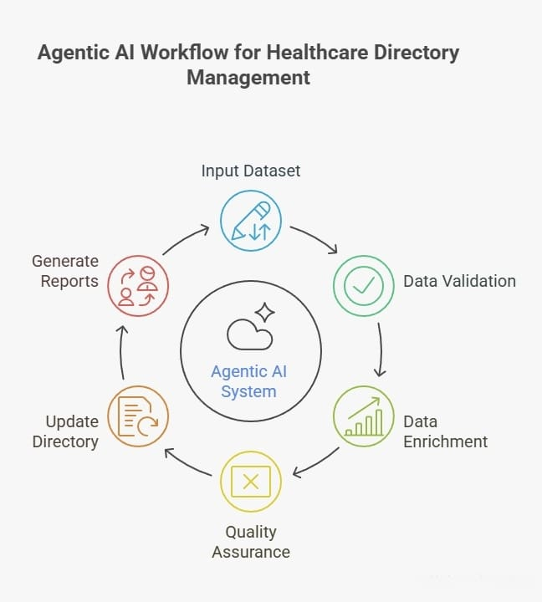
Autonomous AI for Accurate Healthcare Directories
This slide provides an overview of our Agentic AI solution for healthcare provider directory validation and management. Our system leverages a Master Agent to orchestrate specialized Worker Agents, automating data validation, enrichment, and quality assurance, resulting in a more accurate and up-to-date provider directory. This approach significantly reduces manual effort and improves data quality.
Solution Concept: An Agentic AI system validates and enriches provider data from public sources.
Master Agent: Orchestrates the entire workflow, assigning tasks to Worker Agents and consolidating results.
Worker Agents:
  Data Validation Agent: Validates provider information (contact, license,
  address) against public databases.
  Data Enrichment Agent: Enriches existing data with additional
  information from web scraping and APIs.
  QA Agent: Performs quality checks on validated and enriched data,
  flagging potential errors.
  Directory Management Agent: Updates the provider directory with
  validated data and confidence scores.
Tech Stack:
Python-based agents leveraging APIs and web scraping techniques.
Streamlit dashboard for visualization and reporting.
Impact:
Significant reduction in manual validation time (estimated 70% time saving).
Improved data accuracy and directory reliability, leading to better patient care and reduced administrative costs.
Describe your approach to solving the problem

Slide 6
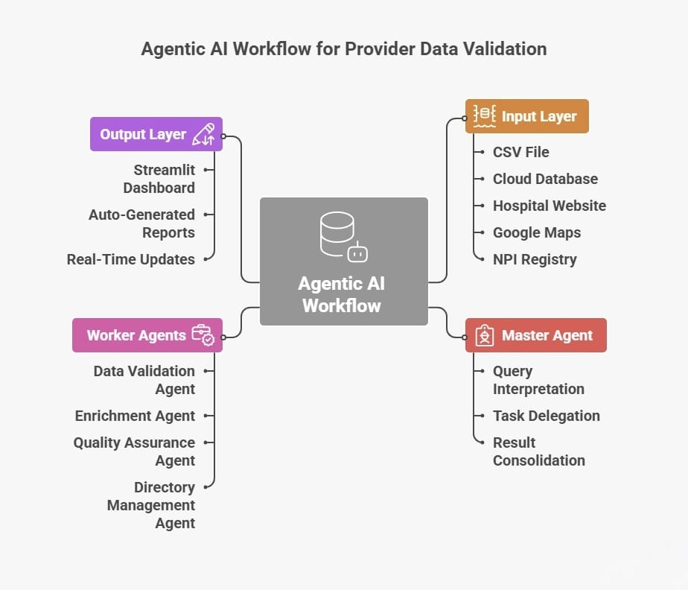
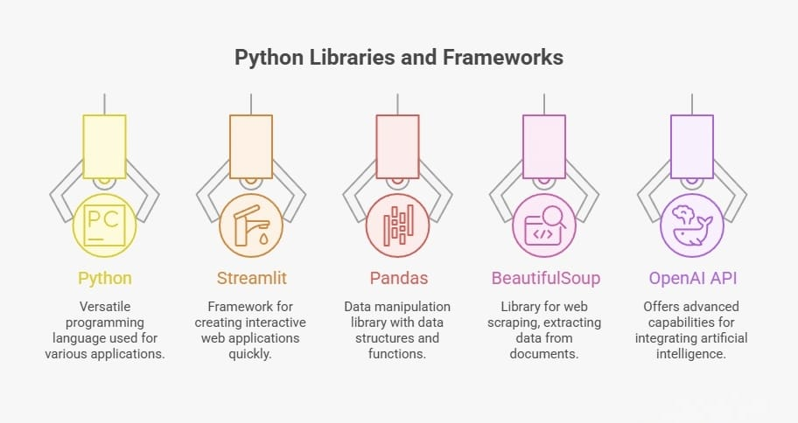
Planned solution design
(Diagram and Key Technology components planned for use)

Slide 7
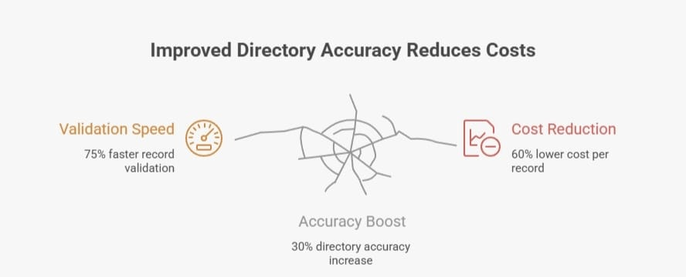
Potential Benefits of Agentic AI-Based Provider Directory Validation
Key Benefits :
Operational:
  Automated validation reduces manual effort by up to 80%.
  Faster data updates and synchronization across systems.
  Improved data governance and compliance with regulatory standards.
Business:
  Reduced operational costs associated with manual verification.
  Improved provider relationships through accurate directory information.
  Enhanced revenue cycle management due to fewer claim denials.
User:
  More accurate and reliable provider information for patients.
  Improved patient access to care through up-to-date directories.
  Reduced call center volume related to directory inaccuracies.
Key Metrics :
Accuracy: Increase provider directory accuracy from 65% to 95%.
Time Saved: Reduce validation time per provider record by 75%.
Cost Efficiency: Lower directory maintenance costs by 60% annually.
Compliance: Achieve 100% compliance with CMS guidelines.
Data Coverage: Increase the number of validated data points per provider by 40%.
Impact Summary:
Achieve a 3× ROI within the first year through reduced operational costs, improved data accuracy, and enhanced compliance.
Potential Benefit from your proposed solution
(Describe in detail the kind of benefit can be planned through your solution, Explain key Matrix, Potential Return on Investment)

Slide 8

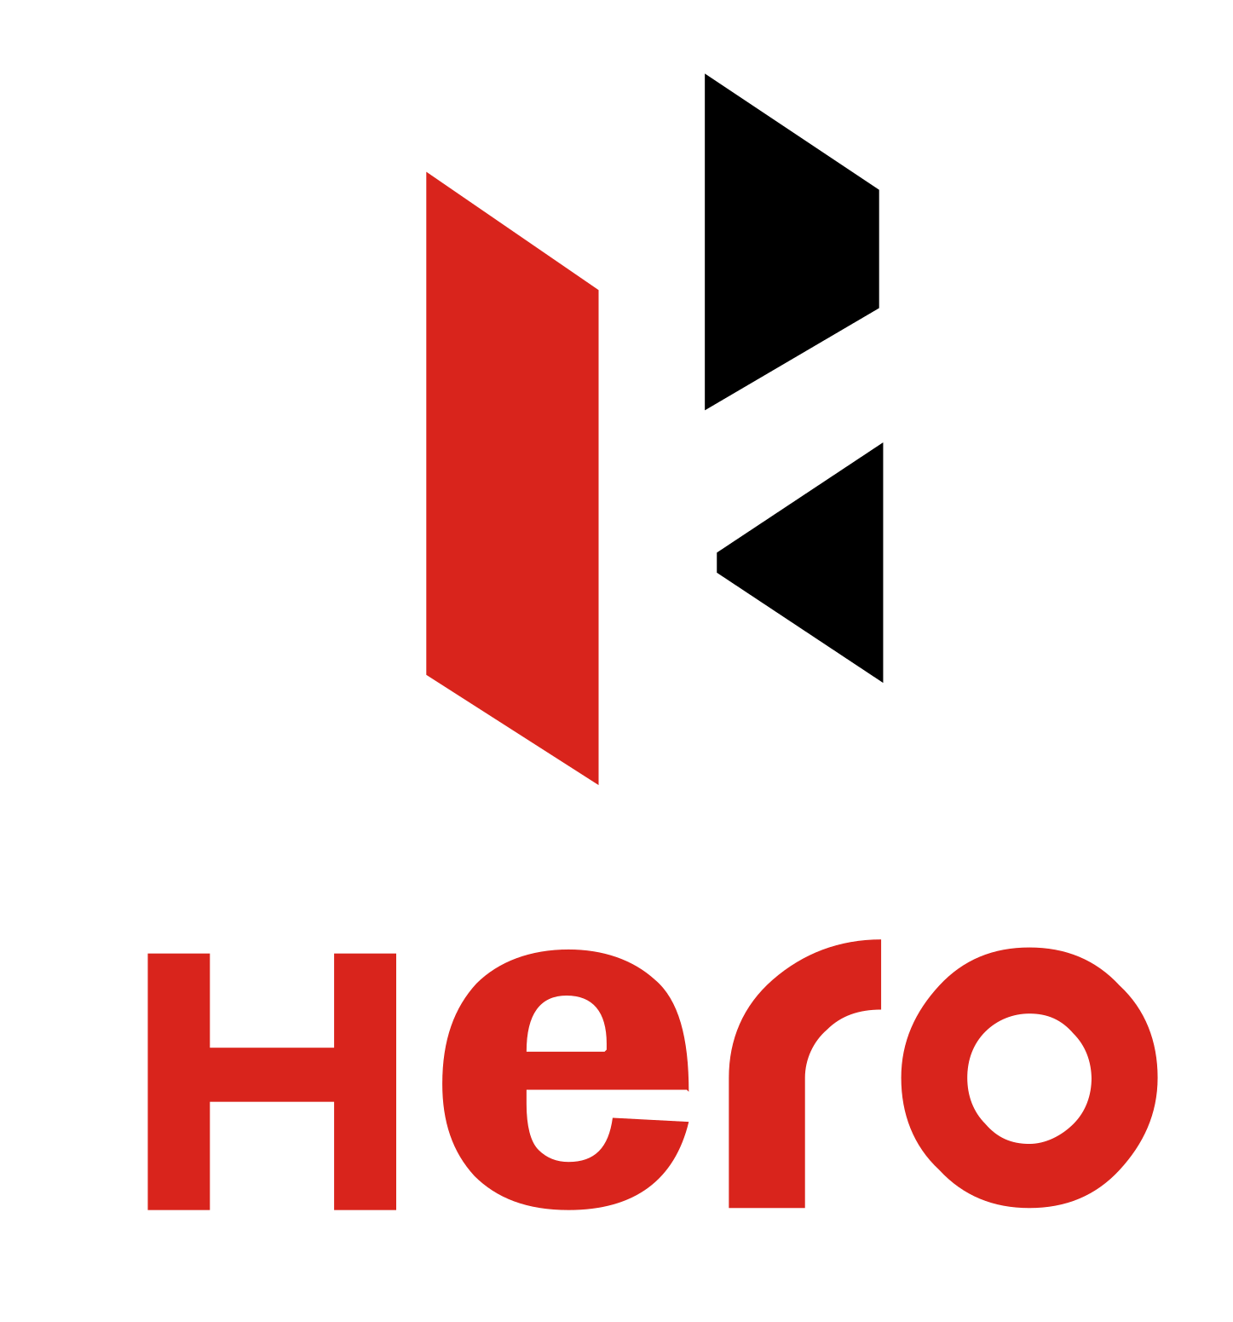






Powered by India's leading enterprises
Thank you for
your attention!

Slide 9


Ernst & Young LLP
EY | Building a better working world
EY is building a better working world by creating new value for clients, people, society and the planet, while building trust in capital markets.
Enabled by data, AI and advanced technology, EY teams help clients shape the future with confidence and develop answers for the most pressing issues of today and tomorrow.
EY teams work across a full spectrum of services in assurance, consulting, tax, strategy and transactions. Fueled by sector insights, a globally connected, multi-disciplinary network and diverse ecosystem partners, EY teams can provide services in more than 150 countries and territories.
All in to shape the future with confidence.
EY refers to the global organization, and may refer to one or more, of the member firms of Ernst & Young Global Limited, each of which is a separate legal entity. Ernst & Young Global Limited, a UK company limited by guarantee, does not provide services to clients. Information about how EY collects and uses personal data and a description of the rights individuals have under data protection legislation are available via ey.com/privacy. EYG member firms do not practice law where prohibited by local laws. For more information about our organization, please visit ey.com.
Ernst & Young LLP is one of the Indian client serving member firms of EYGM Limited. For more information about our organization, please visit www.ey.com/en_in.
Ernst & Young LLP is a Limited Liability Partnership, registered under the Limited Liability Partnership Act, 2008 in India, having its registered office at Ground Floor, Plot No. 67, Institutional Area, Sector - 44, Gurugram - 122 003, Haryana, India.
© 2025 Ernst & Young LLP. Published in India.
All Rights Reserved.
This publication contains information in summary form and is therefore intended for general guidance only. It is not intended to be a substitute for detailed research or the exercise of professional judgment. Neither EYGM Limited nor any other member of the global Ernst & Young organization can accept any responsibility for loss occasioned to any person acting or refraining from action as a result of any material in this publication. On any specific matter, reference should be made to the appropriate advisor.

